Slide 1
IaaS (Amazon EC2)
Unlocking Scalable Cloud Computing

Slide 2
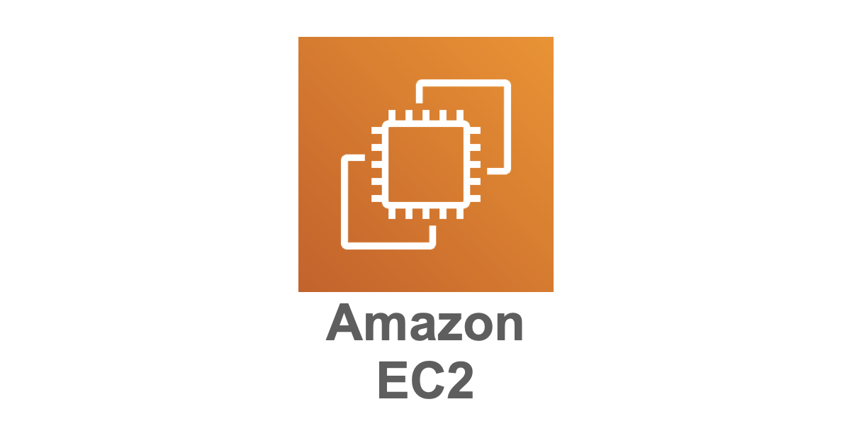
What is Amazon EC2?
Amazon Elastic Compute Cloud (EC2): A web service offering scalable virtual servers.
Primary Goal: Simplify the process of provisioning and managing computing resources.
Key Capabilities: Flexibility, scalability, and cost-effectiveness for deploying applications.

Slide 3
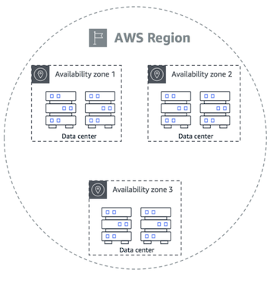
EC2 Architecture Overview
Regions and Availability Zones:
Regions: Geographically separate areas (e.g., US-East-1, AP-South-1).
Availability Zones (AZs): Isolated data centers within regions for fault tolerance.
2. Virtual Machines (Instances): EC2 provides virtualized servers.
3. Elastic Block Store (EBS): Persistent storage for EC2 instances.

Slide 4
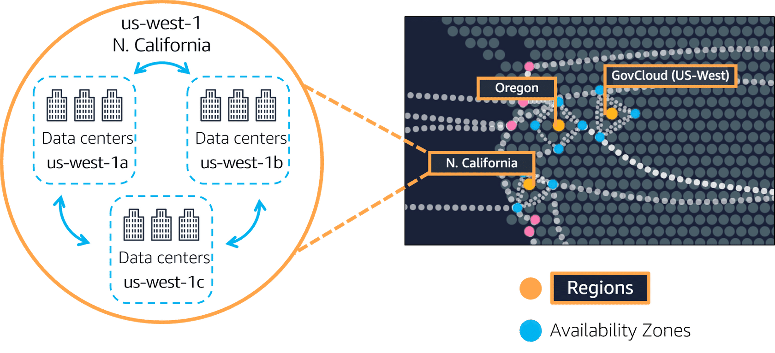
Regions vs Availability Zone vs Data Center

Slide 5
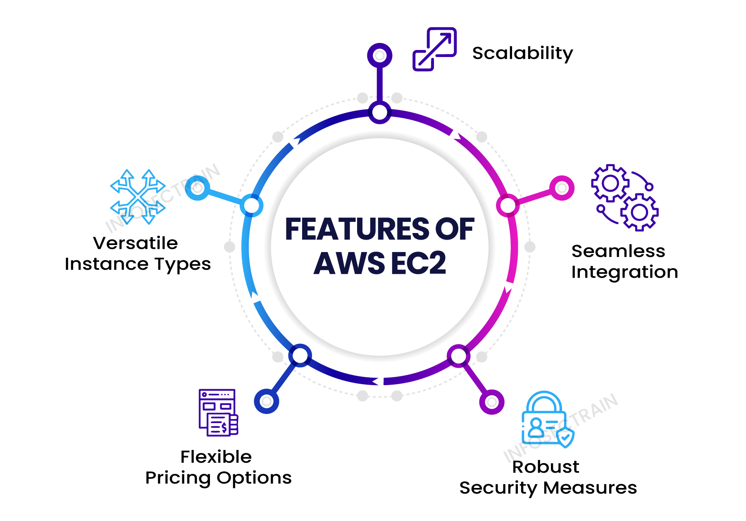
Key Features of Amazon EC2
Elasticity: Scale instances up/down based on workload.
Customizable Configurations: Wide selection of OS, instance types, and storage options.
Cost Management: Multiple pricing models to optimize expenses.
Networking: Secure, isolated environments via Virtual Private Cloud (VPC).
Integration: Works seamlessly with AWS services like S3, RDS, Lambda.

Slide 6
EC2 Instance Types
General Purpose: Balanced performance (e.g., t2.micro).
Compute Optimized: For compute-intensive workloads (e.g., c5.large).
Memory Optimized: For memory-intensive applications (e.g., r5.large).
Storage Optimized: For high-performance storage needs (e.g., i3.large).
Accelerated Computing: For GPU-based workloads (e.g., p3.large).

Slide 7
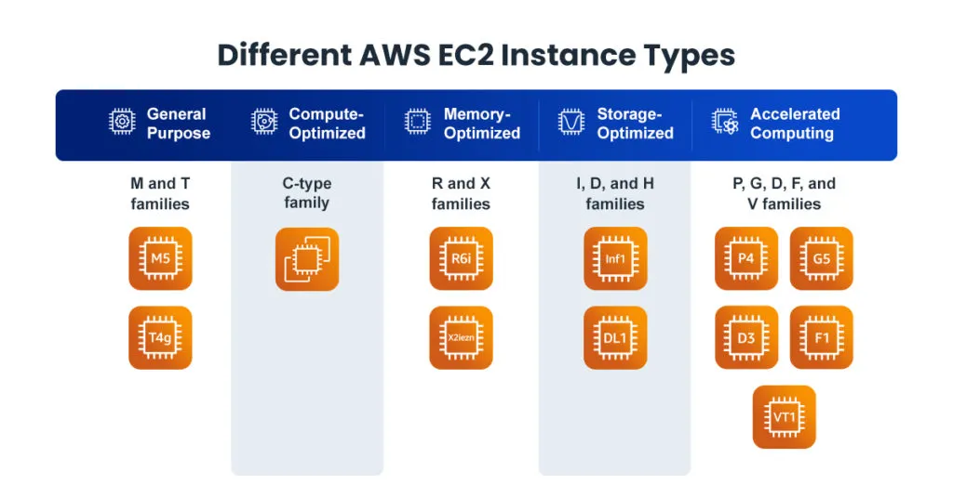

Slide 8
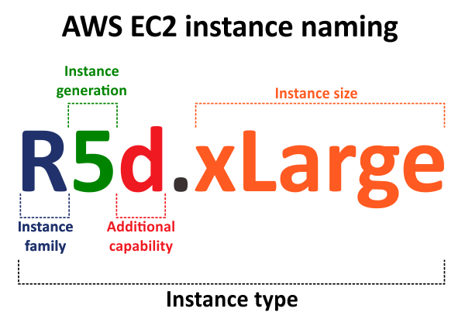

Slide 9
Use Cases of EC2
Web Hosting: Host websites and applications.
Big Data Analytics: Analyze large datasets efficiently.
Machine Learning: Train and deploy ML models.
Gaming: Power online multiplayer games.
DevOps: Test and deploy code in scalable environments.

Slide 10
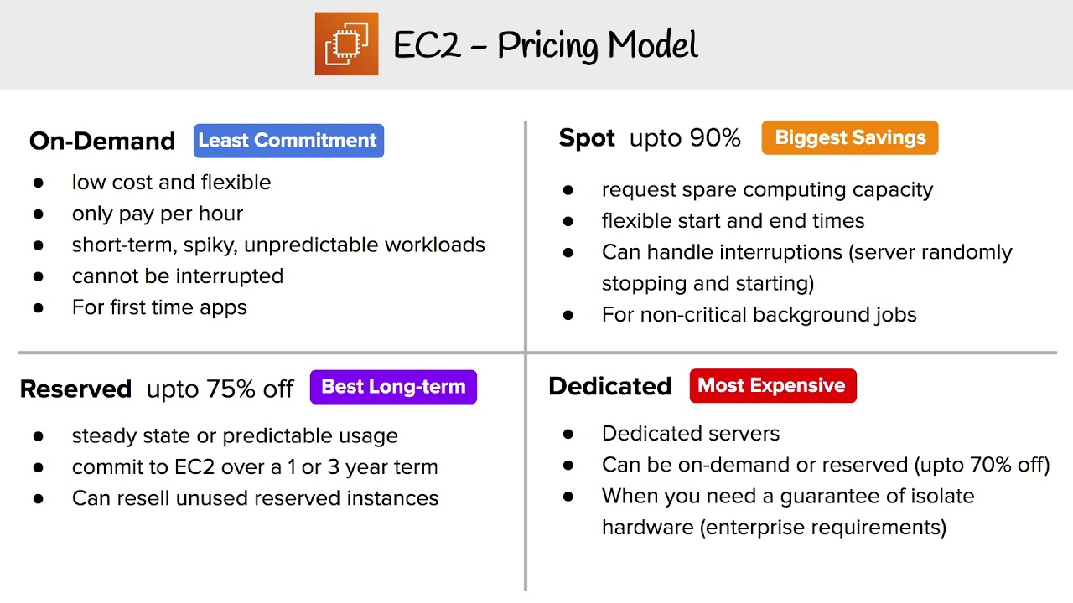
EC2 Pricing Models
On-Demand Instances: Pay for compute capacity per hour or second.
Reserved Instances: Commit for 1-3 years for up to 75% savings.
Spot Instances: Use unused EC2 capacity at steep discounts.
Savings Plans: Flexible pricing plan for long-term savings.
Dedicated Hosts: Dedicated physical servers for compliance requirements.

Slide 11
Security Features of EC2
IAM Integration: Fine-grained access control.
Security Groups: Virtual firewalls to control instance traffic.
Key Pairs: Encrypt connections via SSH.
VPC: Isolated networking environment.
Data Encryption: Encrypt data at rest (EBS, S3) and in transit (TLS).

Slide 12
Storage Options for EC2
Elastic Block Store (EBS): Persistent storage for single instances.
Instance Store: Temporary storage that persists only during instance lifecycle.
Elastic File System (EFS): Scalable file storage for multiple instances.
S3 Integration: Object storage for backups and archives.

Slide 13
EC2 Auto Scaling
Purpose: Automatically adjust compute resources to meet demand.
Benefits:
Reduces costs by scaling down during low demand.
Ensures high availability during traffic spikes.
Components:
Scaling Groups: Define instance pools.
Scaling Policies: Rules for scaling up/down.

Slide 14
Amazon EC2 and Networking
Elastic IP Addresses: Static IP addresses for EC2 instances.
Load Balancers:
Application Load Balancer (ALB): For HTTP/HTTPS traffic.
Network Load Balancer (NLB): For TCP traffic.
VPC Peering: Connect multiple VPCs for seamless communication.

Slide 15
Getting Started with EC2
Log in to the AWS Management Console.
Launch an instance:
Choose AMI (e.g., Ubuntu, Windows Server).
Select instance type (e.g., t2.micro).
Configure storage and networking.
Connect to the instance using SSH or RDP.

Slide 16
Advantages of EC2
Flexibility to choose from various configurations.
Global scalability with low latency.
Integration with other AWS services (e.g., S3, RDS).
Cost-effectiveness with multiple pricing models.

Slide 17
Summary
Amazon EC2 provides scalable, flexible, and cost-effective compute power.
Suitable for diverse use cases, from startups to large enterprises.
Key to leveraging cloud computing benefits in modern applications.

